Slide 1
CSE 3100: Systems Programming
Lecture 3: Flow of Control
Professor Kaleel Mahmood
Department of Computer Science and Engineering
University of Connecticut

Slide 2
1. Control Flow and Blocks
2. If Statements
3. While/For Statements
4. Switch Statements and Common C Mistakes

Slide 3
Flow of Control
.
.
.
.
.
Statements are normally executed sequentially
For selective or repeated execution, we have all the usual suspects from Java/C++/Python:
blocks
if and if-else
while
for
switch
break
continue

Slide 4
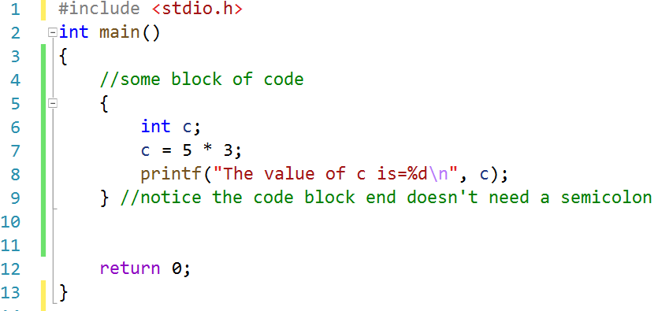
Blocks (compound statements)
List of statements enclosed by { and }

Slide 5
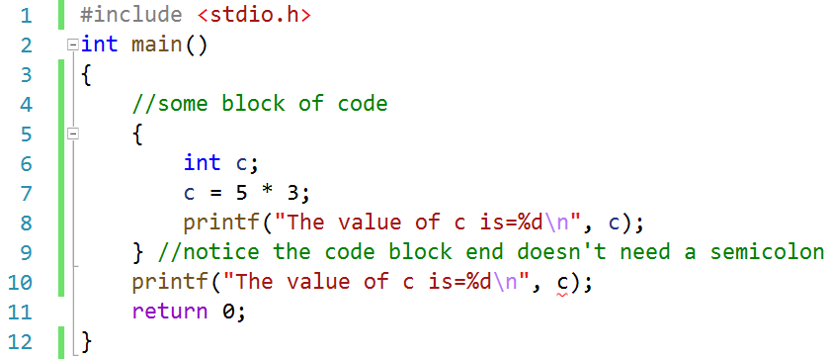
What is the purpose of block statements?
To use local variables which cannot be accessed outside of the block:
This code will actually not even compile.
“c undeclared identifier”

Slide 6
A small historical note:
In C89 ALL variables had to be declared BEFORE usage in a code block:
In C99 (the version we use) this is not the case:
{
int a, b;
a = 3;
b = a * 10;
}
{
int a;
a = 3;
int b;
b = a * 10;
}

Slide 7


Other Notes on Blocks
C Code:
Can be empty
Can be nested (block in block)
Useful for branching/loop statements
Can define variables at the beginning of blocks
Can mix declarations and code in c99
Blocks of C Code:

Slide 8
1. Control Flow and Blocks
2. If Statements
3. While/For Statements
4. Switch Statements and Common C Mistakes

Slide 9
Comparison and logical operators
Operators are commonly used inside of if and else statements.
Comparison operators that compare two expressions
Pay attention to types!
== != > < >= <=
Logical operators
&& || !
The result is either 0 or 1 (of int type)
Again, 0 means false and 1 means true

Slide 10
Branching: if and if-else
if (<exp>)
<stmt>
if (<exp>)
<stmt1>
else
<stmt2>
exp
exp
exp is zero
exp is zero
exp is nonzero
exp is nonzero
stmt
stmt1
stmt2

Slide 11
If Example: Min
int i, j, min;
if (i < j)
min = i;
else
min = j;
// Indentation is not required, above 4 lines are the same as
if (i < j) min = i; else min = j;

Slide 12
Branching: if and if-else
“exp” is typically a comparison or logical expression, but can be ANY expression (float/double, pointer, …)
The statements can be compound statements (blocks) or other if statements.
Beware of the dangling else (“else” matches the nearest preceding “if”, use blocks to disambiguate)
if (<exp>)
<stmt1>
else
<stmt2>

Slide 13
Example: if-else statement with blocks
int i, j, k;
if (i < j) {
k = i;
printf("i is selected.\n");
} // no ; here
else {
k = j;
printf("j is selected.\n");
}

Slide 14
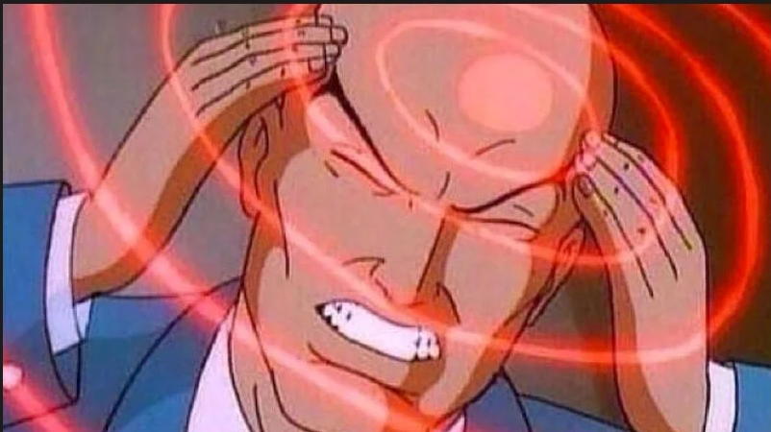
Bad Coding: Dangling else (1/4)
Given the following piece of code:
if (a) if (b) s1++; else s2++; // Avoid this
Assume a is true and b is false. Should we do s1++ or s2++?
Trying to figure out someone’s badly written C code:

Slide 15
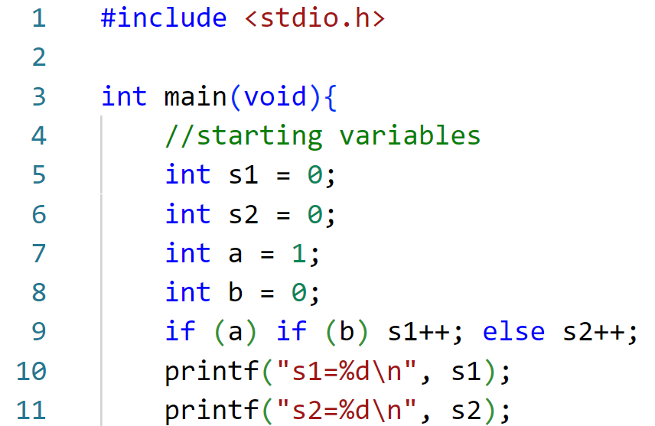
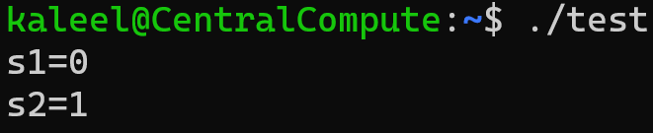
Bad Coding: Dangling else (2/4)
Assume a is true and b is false. Should we do s1++ or s2++?

Slide 16
Bad Coding: Dangling else (3/4)
if (a) if (b) s1++; else s2++; // Avoid this
Instead write more understandable code:
// which 'if' is 'else' associated with?
if (a) {if (b) s1++; else s2++;}
But could we write the above in an even more readable way?

Slide 17
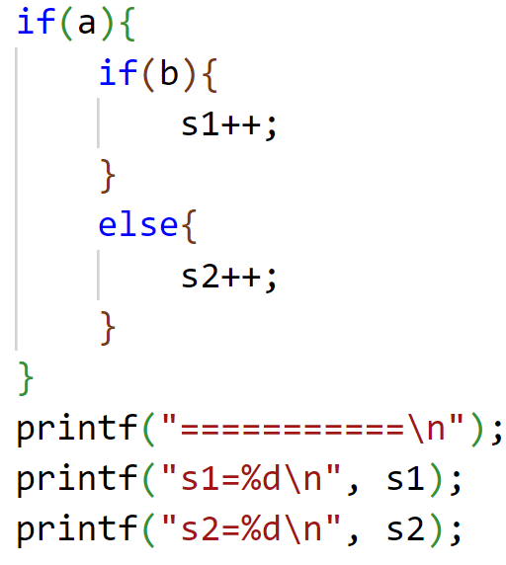
Bad Coding: Dangling else (4/4)
The even better way to write the statement:
BETTER
BAD

Slide 18

Why do we care so much about code readability in C?
Writing your code today:
Trying to read your code later:
if (a) if (b) s1++; else s2++;
if (a) if (b) s1++; else s2++;

Slide 19
Ternary operator
Takes three expressions as operands
exp1 ? exp2 : exp3
exp1 is evaluated first
If exp1 is non-zero (true), exp2 is evaluated and its value is used as the value of the ternary expression
If exp1 is zero (false), exp3 is evaluated and its value is used as the value of the ternary expression
Example:
min = i < j ? i : j;

Slide 20
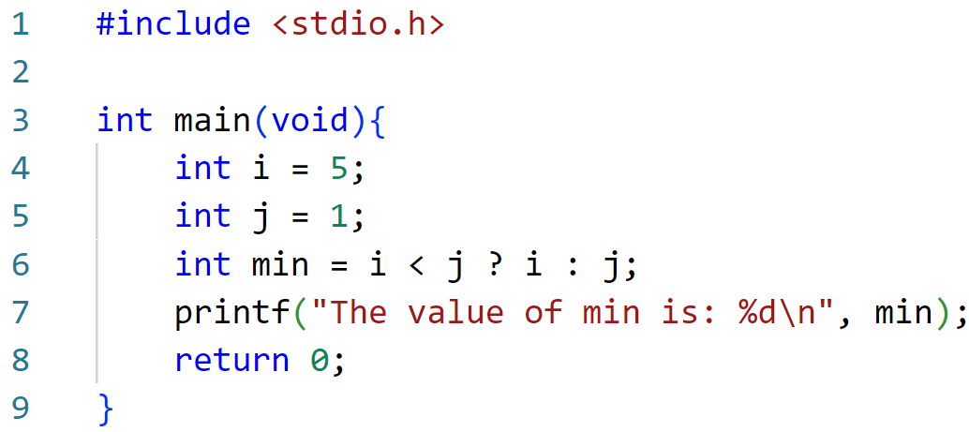
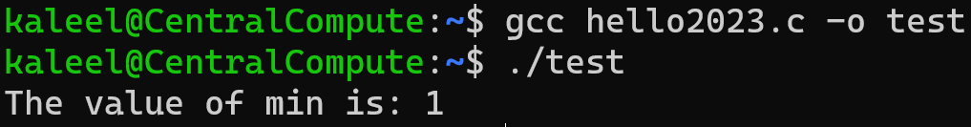
Ternary Operator Coding Example

Slide 21
Multi-way branching using “else if” …
// Assume all variables are defined as int
…
if (i == 0)
n0++;
else if (i == 1)
n1++;
else if (i == 2)
n2++;
else
n_other++;

Slide 22
1. Control Flow and Blocks
2. If Statements
3. While/For Statements
4. Switch Statements and Common C Mistakes

Slide 23
While Loop
while (<exp>)
<stmt>
int i = 0, sum = 0;
while (i < 100) {
sum = sum + i;
i++;
}
// Same as
while (i < 100) sum += i++;
exp
exp is zero
exp is nonzero
stmt

Slide 24
Do-While Loop
do
<stmt>
while (exp);
Checks condition after executing loop body
The statement is executed at least once
Example: computing sum of 0..99
int i = 0, sum = 0;
do {
sum = sum + i;
i++;
} while (i < 100);
stmt
exp
exp is nonzero
exp is zero

Slide 25
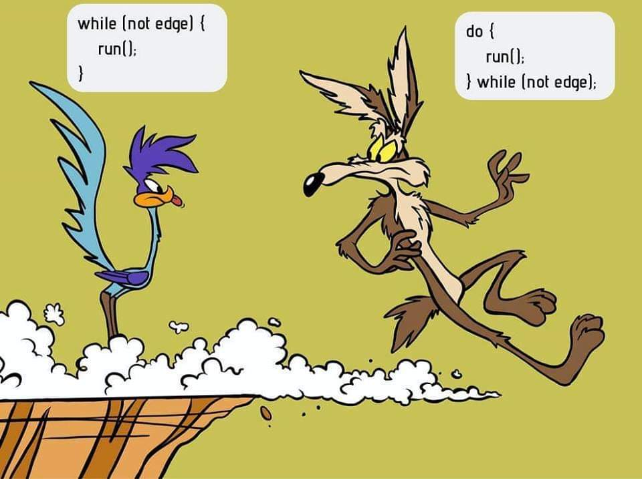
While vs Do-While Loop

Slide 26
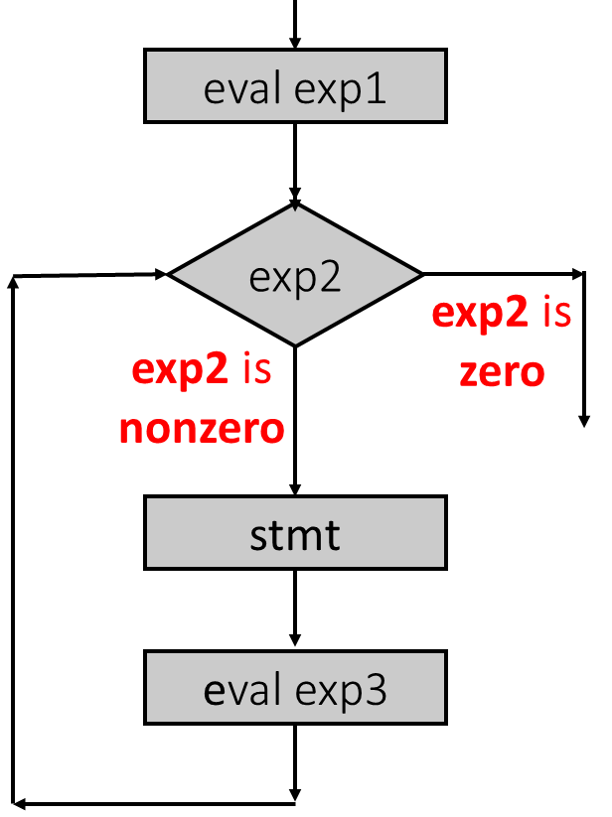
For Loop
for( <exp1>; <exp2>; <exp3>)
<stmt>
Sometimes called “counting” loop
More like swiss-army knife!
Three expressions:
Initialization, condition, increment
Equivalent to
exp1;
while (exp2) {
<stmt>
exp3;
}

Slide 27
Computing sum of 0..99 using for
int i, sum;
// one way
sum = 0;
for (i = 0; i < 100; i++) sum = sum + i;
// another way, with all initializations inside
for (sum = i = 0; i < 100; i++) sum += i;
// yet another way, with empty body
for (sum = i = 0; i < 100; sum += i++);
// yet another, using comma operator
for (sum = 0, i = 0; i < 100; sum += i, i++);

Slide 28
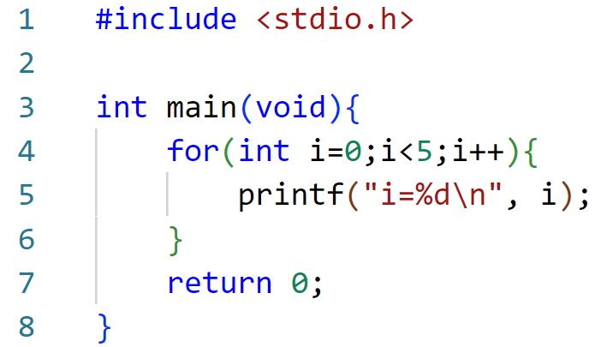

For Loop Coding Example (Compact)
All variables for the “for loop” are declared with the loop.

Slide 29
Comma operator
Takes two expressions
exp1 , exp2
exp1 is evaluated first, then exp2 is evaluated
exp2 is the result of the whole expression
Has the lowest precedence
Associates from left to right
exp1, exp2, exp3 ⬅➔ (exp1, exp2), exp3
Order can make a difference, e.g.,
for (sum = 0, i = 0; i < 100; sum += i, i++);
is not the same as
for (sum = 0, i = 0; i < 100; i++, sum += i);

Slide 30
1. Control Flow and Blocks
2. If Statements
3. While/For Statements
4. Switch Statements and Common C Mistakes

Slide 31
Switch Statements
Also called “selection” statement
switch (<integer expression>) {
case <integer constant1>:
<statements>
case <integer constant>:
case <integer constant>:
<statements>
default:
<statements>
}

Slide 32
Switch Example
// Assume all variables are defined as int
switch (i) {
case 0:
n0 ++; break; // Note the break statement
case 1: // No break for case 1. Will continue.
case 2:
{ // Can put a block here and define new variables
int a = d + 10;
n1 = a * 10; break; }
default:
n_other ++;
}

Slide 33
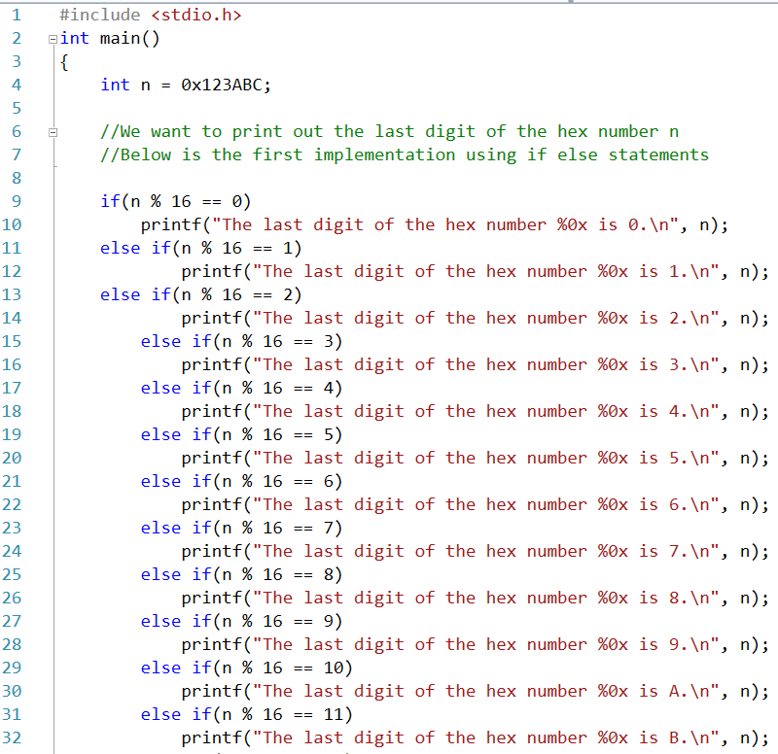
Where would we need to use switch?
Consider the scenario where we need to test the output of some operation with a lot of different outcomes.
We could write it using if and else if…

Slide 34
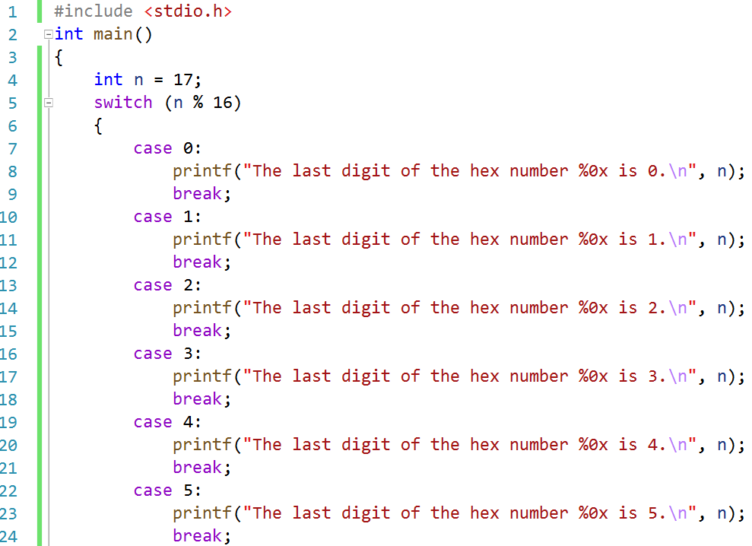
Where would we need to use switch?

Slide 35
Break Statement
Most commonly used in switch statements
Prevents “fall-through” to the next case
Also works in loops (for, while, do-while)
Loop execution terminated immediately, control resumes at statement immediately following the loop
switch (a) {
…
break;
…
} // end of switch
…
{ // begin loop body
…
break;
…
} // end loop body
…

Slide 36
Continue Statement
Skip the rest of current loop iteration and continue to the next one
Can be used within for, while, and do-while loops
Can appear in a nested if / else
If used in nested loops, it applies to the “innermost” enclosing loop
For “for” loops, go to the evaluation of the “increment” expression
{ // begin loop body
…
continue;
…
} // end loop body

Slide 37
Common Mistakes in C coding 1
Confusing assignments and tests for equality
x=8 vs. x==8
Confusing logical and bitwise ops
x && y vs. x & y
Forgetting the "break" statements in a switch
Dangling else in nested if-then-else

Slide 38
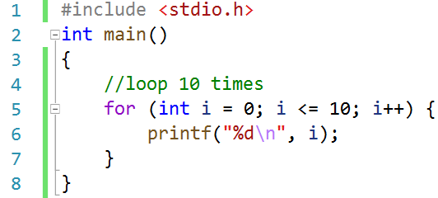
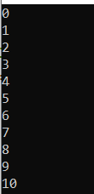
Common Mistakes in C coding 2
Looping the right amount of times. Let’s say we want to loop 10 times:

Slide 39
Figure Sources
https://preview.redd.it/rvir9ttjg1a11.png?auto=webp&s=69a4976a0df629d77c43497b9358d9a3a918f571
https://static.wikia.nocookie.net/tomandjerry/images/2/2b/Tom-de-brazos-cruzados11578470925.jpg/revision/latest/scale-to-width-down/1200?cb=20210224013420
https://preview.redd.it/sllzna67f6k61.jpg?auto=webp&s=edfe83e6b7fd4c9f0dd51c3c72d9be2facd310b3
https://i.imgflip.com/3efwu7.jpg?a470208
https://preview.redd.it/6wksqjmmyw321.jpg?auto=webp&s=aceebdeb23af98598c2508b42f77debbcd36cf4b

